Slide 1
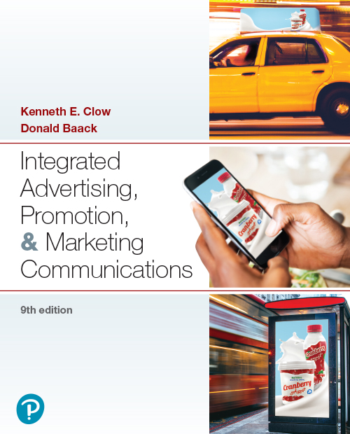

Integrated Advertising, Promotion, and Marketing Communications
Ninth Edition
Chapter 6
Advertising Design
Copyright © 2022, 2018, 2016 Pearson Education, Inc. All Rights Reserved
Notes:
If this PowerPoint presentation contains mathematical equations, you may need to check that your computer has the following installed:
1) MathType Plugin
2) Math Player (free versions available)
3) NVDA Reader (free versions available)

Slide 2
Chapter Objectives
6.1 How do marketers use message strategies to design effective advertisements?
6.2 What are the seven main types of advertising appeals?
6.3 What role does the executional framework play in advertising design?
6.4 How are sources and spokespersons featured in advertising designs?
6.5 What kinds of adjustments are necessary when undertaking advertising design in international settings?
Notes:
These are the objectives for Chapter 6.

Slide 3
Chapter Overview
Message strategies
Advertising appeals
Executional frameworks
Sources and spokespersons
International settings
Notes:
Chapter 6 presents information on advertising design. It focuses on types of message strategies, appeals, and ad executions. This chapter examines three primary advertising design issues – message strategies, appeals, and executional frameworks. While discussed separately, decisions about ad design incorporate all three elements. Finally, the chapter discusses characteristics of strong sources and spokespersons, along with adjustments that must be made when designing advertising in international settings.

Slide 4
Adweek Media and Harris Interactive Survey
Ads somewhat or very interesting (55%)
Ads not interesting at all (13%)
Ads very influential in purchase decisions (6%)
Ads somewhat influential in purchase decisions (29%)
Nearly half of 18-34 year-olds influenced by advertising
37% of 35-44 year-olds influenced by advertising
28% of individuals 45+ influenced by advertising
Notes:
Adweek Media and Harris Interactive conducted a survey of consumers about their attitudes toward advertising. 55% said ads were somewhat or very interesting compared to only 13% who said advertising was not interesting at all. About 6% said ads were very influential in the purchase decisions they made, and 29% said ads were somewhat influential in purchase decisions. About half of the survey respondents in the 18- to 34-year-old age bracket were influenced by advertising. The percentage dropped to 37% for individuals 35 to 44 and 28% for individuals 45 and older.

Slide 5

McGarryBowen
Founded 2002 with strategic approach
“Gracious” and “tenacious”
Emphasis on collaboration
Notes:
The mcgarrybowen advertising agency was founded in 2002 with the design to be both “gracious” and “tenacious.” Over the past decade, it has picked up an impressive list of clients such as Chevron, Canon, Disney, JP Morgan, Kraft, Oscar Mayer, and Pfizer. This full-service agency believes in people and emphasizes collaboration among employees and with clients. To achieve marketing goals, the creative staff utilizes a storytelling approach and strategic planning. Rather than integration, the goal is unification.

Slide 6
Figure 6.1: Message Strategies
Cognitive
Generic
Unique selling proposition
Hyperbole
Comparative
Affective
Resonance
Emotional
Conative
Notes:
The message theme outlines the key ideas in an advertisement. It is a central part of the creative brief. The message then can be created using a number of different message strategies, the primary tactic or approach used to deliver the message theme. Message strategies can be divided into three main categories that correspond with the three components of attitude – cognitive, affective, and conative. Let’s take a closer look at these…

Slide 7
Message Strategies (1 of 3)
Cognitive
Generic
Preemptive
Unique selling proposition
Hyperbole
Comparative
Notes:
A cognitive message strategy presents rational arguments or pieces of information to consumers. Cognitive message strategies are designed to influence the cognitive component of attitude, which deals with beliefs and knowledge. Cognitive message strategies can be divided into five types – generic, preemptive, unique selling proposition, hyperbole, and comparative.

Slide 8

Generic Cognitive Message Strategy
How does this ad rely on a generic message strategy?
Notes:
A generic cognitive message strategy promotes a brand’s attributes or benefits without any claim of superiority. This TruChoice advertisement concentrates on the cognitive aspects of purchasing and financing seeds for a farming enterprise.

Slide 9
Preemptive Cognitive Message Strategy
Claim of superiority based on attribute or benefit
Prevent competition from making same claim
First to state advantage
Notes:
A preemptive cognitive message strategy makes a claim of superiority based on a product’s specific attribute or benefit with the intent of preventing the competition from making the same claim.

Slide 10
Unique Selling Proposition Cognitive Message Strategy
Focuses on a testable claim of:
Uniqueness
Superiority
Can be supported in some manner
Example: HelloFresh offers the fastest delivery times
Notes:
A unique selling proposition message strategy focuses on a testable claim of uniqueness or superiority.

Slide 11

Hyperbole Advertising Cognitive Message Strategy
Untestable claim
Does not require substantiation
Popular cognitive approach
Notes:
A hyperbole cognitive message strategy is an untestable claim based on some attribute or benefit. It does not require substantiation, which makes it a popular cognitive strategy approach. Notice this ad uses hyperbole with the statement, “Bigger rewards are here.”

Slide 12
Comparative Advertising Cognitive Message Strategy
Direct or indirect comparisons
Real or fictitious competitor
Advantage – captures attention
Brand awareness increases
Message awareness increases
Negative – less believable, negative attitude
Negative comparative ad
Spontaneous trait transference
Choose comparisons carefully
Notes:
A comparative cognitive message strategy focuses on a direct or indirect comparison to a competing brand. The brand can be real, mentioned, or fictitious. The advantage of comparative ads is that they tend to capture attention. Brand awareness and message awareness tend to be higher. The negative aspect is that they can be less believable and can create a negative attitude. This is most likely to occur when a negative comparison approach is used in the ad, downgrading the competing brand. If the consumer does not believe the ad, then spontaneous trait transference can occur, which is placing the negative trait on the advertised brand instead of the competitor. It is important to choose competitors wisely in making comparisons.

Slide 13
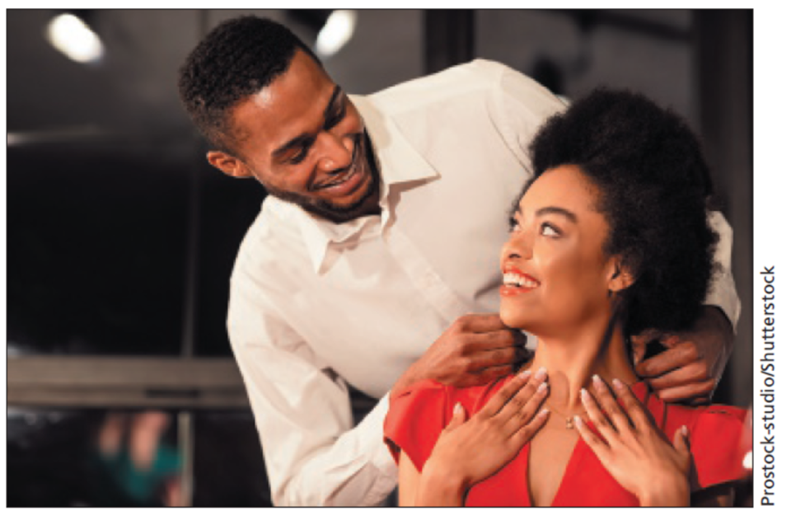
Message Strategies (2 of 3)
Affective
Resonance
Emotional
Notes:
Advertisements that invoke feelings or emotions are affective message strategies. These messages attempt to enhance the likeability of a product, recall of the message, and comprehension of the message. The two types of affective message strategies are resonance and emotional. Resonance advertising connects a product with a consumer’s experiences from the past in order to develop a bond with the brand. Often, advertisers will use music from that generation to create an emotional bond. Emotional messages attempt to elicit emotions that will lead to product recall and choice. Many different emotions can be connected with a product. Emotional messages are used in both consumer and business-to-business advertising. Affective message strategies help develop brand equity by creating an emotional bond with the brand. As shown in this advertisement, many ads for jewelry seek to elicit a strong emotional response designed to enhance and increase brand awareness.

Slide 14
Affective Message Strategy (1 of 2)
Invokes feelings or emotions
Attempts to enhance likeability
Resonance Advertising
Connects with consumer experiences
Comfort marketing
Emotional Advertising
Emotions lead to recall and choice
Consumer and b-to-b markets
Leads to positive feelings
Notes:
Affective message strategies invoke feelings or emotions with the goal of enhancing likeability, recall, and comprehension. Affective strategies can be resonance or emotional. Resonance advertising connects a brand with a consumer’s experience. A new form of resonance advertising is comfort marketing. This encourages consumers to purchase a brand rather than a generic product because brands have stood the test of time, and consumers can take comfort in them. Emotional advertising elicits powerful emotions that lead to recall and choice.

Slide 15

Affective Message Strategy (2 of 2)
This ad for South Walton, Florida uses an affective message strategy.
Notes:
Can you identify the emotional affective message strategy in this ad? What is it?

Slide 16

Message Strategies (3 of 3)
Conative
Encourages customer action
Supports promotional efforts
Can encourage impulse buys
Notes:
Conative message strategies are designed to lead directly to some type of action or response. The strategy encourages consumers (or businesses) to act in some way, to do something like make an inquiry or access a website for more information. It can be tied with some type of promotion like a coupon, contest, or sweepstakes. This conative advertisement for Cross Keys Bank seeks to move consumers to open accounts but also avoids the assertive advertising approach.

Slide 17
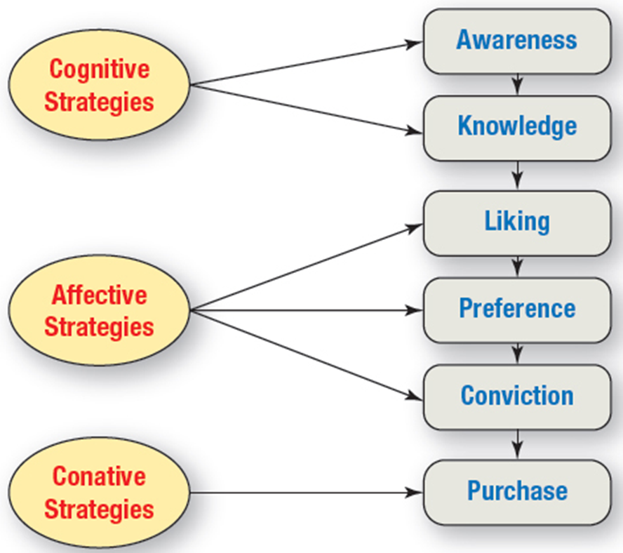
Figure 6.2: The Hierarchy of Effects Model and Message Strategies
Notes:
Because message strategies correspond to the components of attitude, they can be matched with the different stages of the Hierarchy of Effects Model. Cognitive strategies deal with awareness and knowledge. Affective strategies deal with emotions and the stages of liking, preference, and conviction. Conative strategies encourage action and match the purchase phase of the model.
The diagram is structured into topics and subtopics as follows.
Cognitive strategies
Awareness
Knowledge
Affective strategies
Liking
Preference
Conviction
Conative strategies
Purchase
Each topic flows into its subtopics from left to right, and each subtopic flows into the next subtopic from top to bottom.

Slide 18
Questions to Consider (1 of 2)
Think about the message strategies we have just discussed:
Cognitive
Affective
Conative
What examples of effective advertising can you think of in each of these categories?
Did the ads stimulate you to buy something? If so, what made it work for you?
Notes:
For these questions, encourage students to think about advertising examples from their own lives and from brands they like. What kinds of purchases did they make as a result?

Slide 19
Figure 6.3: Types of Appeals
Fear
Humor
Music
Rationality
Emotions
Scarcity
Notes:
Advertisers have seven different types of appeals they can use. The type of appeal chosen should be based on the creative brief and the objectives of the ad campaign. If a means-end chain has been developed, then ideas on which appeal would work the best can be generated. While almost any appeal can work in any situation, some appeals would be more appropriate than others. In some cases, a particular appeal may be unacceptable to the target audience or to the client.

Slide 20
Fear Appeals (1 of 2)
Fear increases interest and is memorable
Severity and vulnerability
Severity – level of consequence
Vulnerability – probability of event occurring
Rewards to response efficacy
Intrinsic reward
Extrinsic reward
Response costs
Self-efficacy
Response efficacy
Notes:
Fear appeals are common and are used for products ranging from insurance, to home security systems, to deodorant. Fear appeals increase interest and are remembered by individuals. Severity is the level of consequence that will occur, and vulnerability is the probability of the event happening. Response efficacy is the likelihood that a change in behavior or actions will result in a desirable positive consequence. Intrinsic reward is the internal satisfaction, and extrinsic reward is the value of the event or reward received. Response cost is the cost or sacrifice the person will need to make to obtain the reward. Self-efficacy is the confidence a person has in his/her own ability to engage in the action, or to stop an undesirable behavior. All of these factors influence the effectiveness of an ad using a fear appeal.

Slide 21
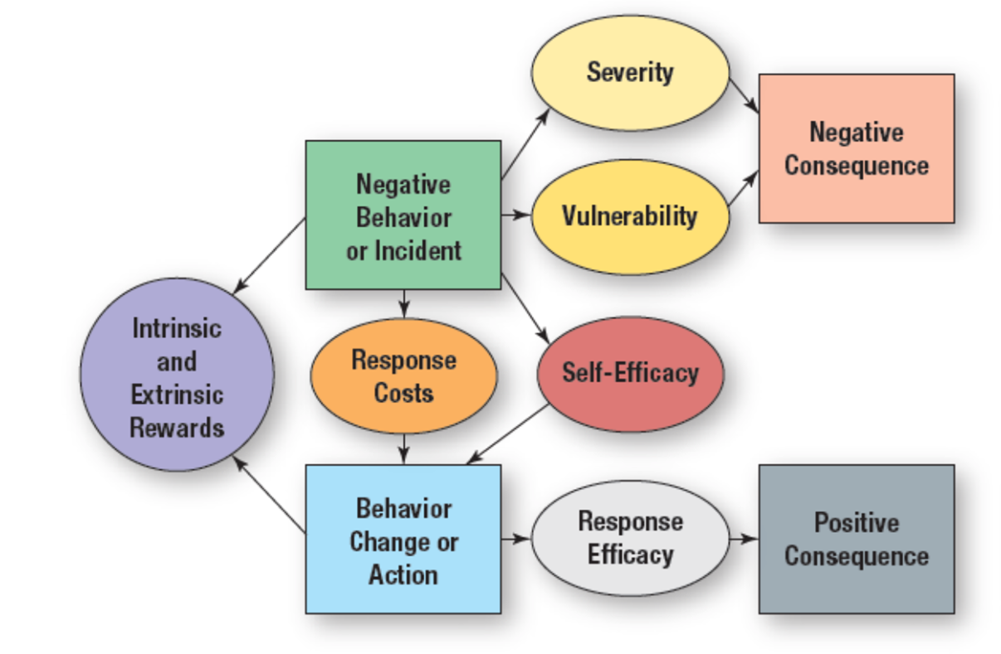
Figure 6.4: The Behavioral Response Model
Notes:
The behavioral response model explains how fear appeals work. For a product such as a home security system, an ad can focus on severity, what happens when a home is broken into, or vulnerability, the probability of it actually occurring. The ad can show the negative consequences of such an event. An ad can show the intrinsic and extrinsic rewards from installing a security system. Response efficacy can be illustrated by the alarm going off when a burglar tries to enter, and the police are called. Peace of mind and security are then shown as the positive consequence. The diagram flows as follows.
Negative behavior or incident flows to
Severity which flows to
Negative consequence
Vulnerability which flows to
Negative consequence
Self efficacy flows to
Behavior change or action which flows to
Response efficacy which flows to
Positive consequence
Negative behavior or incident flows to
Response costs which flow to
Behavior change or action
Negative behavior or incident and Behavior change or action flow to intrinsic and extrinsic rewards.

Slide 22

Fear Appeals (2 of 2)
Appeal strength
Low may not be noticed
High may backfire
Moderate works best
Notes:
This business-to-business ad uses a fear appeal with the headline “We won’t hang you out to dry.” The copy then explains what ReRez can do for a business that wants marketing research. The fear appeal is strong enough to get attention, especially the visual, but not so strong that it is ignored.

Slide 23
Humor Appeals (1 of 2)
Cuts through advertising clutter
Good at grabbing and keeping attention
Offers intrusive value, attracts attention
Causes consumers to
Watch
Laugh
Remember
Notes:
Humor is an excellent appeal for cutting through advertising clutter, and grabbing and keeping someone’s attention. Humor causes individuals to stop what they are doing, watch, laugh at, and then remember the ad. In recall tests, consumers most often remembered humorous ads over ads with other types of appeals. The best results occur when the humor is connected naturally with the product.

Slide 24
Humor Appeals (2 of 2)
Advantages of humor
Piques interest
Increases recall and comprehension
Problems with humor
Can be offensive
Can overpower message
Humor should focus on product
International usage
Humor is rooted in culture
Humor varies across countries
Notes:
Humor appeals offer a number of advantages. Humor piques consumer interest. Humor increases recall and comprehension of ads. Humor elevates people’s moods, and if people feel good about an ad, they tend to think positively about the brand being advertised. Problems occur when the humor is offensive or overpowers the message. At times, people can recall an ad and describe it in detail, but not remember the brand being promoted. When that occurs, the ad has failed. To prevent the humor from overpowering the message, the humor should focus on the product and not stand alone. Humor is rooted in culture, so what is funny in one country is not likely to be funny in another. Good humor that is remembered and that is connected with the brand is difficult to achieve.

Slide 25
Figure 6.5: Reasons for Using Humor in Ads
Captures attention
Holds attention
Often wins creative awards
High recall scores
Consumers enjoy ads that make them laugh
Evaluated by consumers as likeable ads
Notes:
Advertisers use humor because it works. It captures attention. It holds people’s attention. Humor often wins creative awards at competitions. Humor produces a high level of recall on recall tests. People enjoy humor; they like to laugh. When comparing ads, most people evaluate humorous ads as ones they like best.

Slide 26

Sex Appeals
Break through clutter
Use has increased
Effectiveness has declined
Advertisers shifting to more subtle sexual cues
Notes:
Sex appeals are often used to break advertising clutter. The use of sex appeals has increased in the United States and in many other countries. The problem is that sex appeals may not carry the impact they used to because children are growing up exposed to sexual themes all around them. As a result, many advertisers are moving to more subtle sexual clues and a softer sexual approach. This advertisement for milk features a mild sex appeal.

Slide 27
Figure 6.6: Sexuality Approaches Used in Advertising
Subliminal techniques
Sensuality
Sexual suggestiveness
Nudity or partial nudity
Overt sexuality
Notes:
Advertisers have five different approaches they can use with sex appeals. They range from very subliminal messages to overt sexuality.

Slide 28
Sexual Appeal Approaches (1 of 2)
Subliminal approach
Places cues or icons in ads
Not effective
Sensuality
Women respond more favourably
More sophisticated
Relies on imagination
Notes:
The subliminal approach places sexual cues or icons in an advertisement with the idea of affecting the subconscious is subliminal advertising. Research has shown that subliminal advertising does not work. It is not effective. Ad clutter requires stronger ads that get attention. The sensuality approach conveys sex, but in a loving, romantic way. Women respond more favorably to a sensuous approach. It is viewed as more sophisticated and relies on a person’s imagination. Because it relies on imagination, the viewer can put their own positive spin on what they think will occur. Images of romance and love can be more enticing to viewers of an ad than raw sexuality. Sexual suggestiveness is a stronger hint about having sex, or a sexual theme. Recent ads have focused on women watching men who were shirtless or nearly nude, suggesting sexual fantasies that could occur with the man.

Slide 29
Figure 6.7: Factors to Consider Before Using Decorative Models
Improve ad recognition but not brand recognition
Influence emotional and objective evaluations
Attractive models produce a higher level of attention than less attractive models
Produce higher purchase intentions when product is sexually relevant
Notes:
Before using a decorative model, companies should consider several factors. First, using decorative models does improve ad recognition, but it does not improve brand recognition. Recalling the ad but not the brand is not good. Second, decorative models influence emotional and objective evaluations of the product for both male and female audiences. Third, attractive models produce higher levels of attention than less attractive models for both males and females. Fourth, decorative models produce higher purchase intentions when the product is sexually relevant.

Slide 30

Effectiveness of Sex Appeals
Increase attention
Brand recall lower
Physiological arousal
Cognitive impressions
Like versus dislike
Consider societal trends
Notes:
Are sex appeals effective? Ads with sexual themes do attract attention. However, brand recall may be lower. Overt sexual ads, overt sexual cues, and nudity will increase physiological arousal. The cognitive impressions made in ads with sex appeals vary depending on the viewer. If the person likes the ad, then a positive cognitive impression is made of the brand. If they dislike the ad, then a negative cognitive impression is made of the brand. Societal trends also impact the use of sex appeals, especially in global markets.

Slide 31

Criticisms of Sex Appeals
Can create dissatisfaction with one’s body in both sexes
It objectifies women
Dove’s Campaign for Real Beauty, others, help combat this problem
Notes:
Sexual appeals in advertising are not all positive. A number of disadvantages are present. Using sex in advertising today has less influence because sex is common on television and in movies. Sexual themes interfere with brand recall and affect ad comprehension. A negative societal consequence is that such appeals may cause a greater dissatisfaction with the viewer’s own body. Females feel they are too fat. Males feel they are not strong or muscular enough. Sex appeals have also led to the objectifying of women. Dove’s Campaign for Real Beauty and others like it have worked to combat this problem.

Slide 32
Music Appeals (1 of 3)
Connects with emotions and memories
Has intrusive value
Gains attention
Increases the retention of visual information
Improves recall
Can increase persuasiveness
Notes:
Music is an important part of advertising. It connects with emotions and generates memories. It has intrusive value and gets attention. Music increases the retention of visual information. It produces higher recall scores and can increase persuasiveness. Consumers often tie particular music to a specific brand of product.

Slide 33

Music Appeals (2 of 3)
Variety of roles in advertisements
Incidental to ad
Primary theme
Selecting the music
Use a familiar tune
Write a jingle
Background or mood music
Marketers work with musicians
Notes:
Music can play a variety of roles in ads. It can be incidental to the ad, hardly noticed by viewers, or it can be the central theme of the ad. The role it will assume impacts the type of music that will be selected. Advertisers can use a familiar tune, or they can write a jingle or new song. Music can be for background purposes or to create a certain mood as the ad progresses. In recent years, advertisers have worked more with musicians to create original new music for advertisements.

Slide 34
Music Appeals (3 of 3)
Advantages of music appeals
Consumers have affinity with existing songs
Brand awareness, brand equity, and brand loyalty become easier
Emotional affinity transference to brand
Popular songs expensive
Alternative methods
Musicians see ad songs as way to be heard
Songs posted on YouTube and other sites
Occasionally full song becomes popular
Notes:
Music appeals offer a number of advantages. Consumers have an affinity with existing songs, so when an existing song is used, consumers have already heard it and most have developed emotions with it. Brand awareness, brand equity, and brand loyalty become easier with music appeals. Even for new songs, consumers transfer affinity and positive feelings from the song to the brand. Musicians have become more open to writing and performing songs for ads. It gives them a way to be heard. Songs are often posted on YouTube and other sites. Occasionally, the full song version of a tune written for an ad will become popular and move to other music outlets.

Slide 35
Rational Appeals
Based on hierarchy of effects model
Active processing of information
Media outlets
Print media and internet best mediums
Business-to-business
Print media, trade publications
Information search by buying center members
Product attributes
Complex and high involvement products
If processed, excellent at changing attitudes
Notes:
Rational appeals are based on the hierarchy of effects model and the sequence of steps outlined in the model. It implies active processing of information. Rational appeals work best for print ads where longer copy can be inserted and online where there is very little limit to what copy can be inserted. Rational appeals are common in business-to-business ads, again in print media, especially trade publications. When members of the buying center are searching for information, ads using rational appeals can be effective. Rational appeals work well for complex and high involvement products. If a person processes the information in a rational ad, it is excellent at changing attitudes. The question is, will consumers stop and look or listen to the ad and process the information?

Slide 36
Emotional Appeals
Brand loyalty
Key to developing brand loyalty
Creates bond with brand
Business-to-Business
Used more frequently (25%)
Emotions important in business decisions
Media outlets
Television best medium
Internet
Work well when tied with other appeals
Notes:
Most advertising creatives believe that emotions are the key to developing brand loyalty. Emotions and feelings will create bonds with a brand. Emotional appeals are becoming more common in B-to-B advertising and are now used in about 25% of all business ads. The rationale is that business buyers are people also, and even in business decisions, emotions are an important component. Emotional appeals work really well for television, where people can see and hear the emotions. They also work well on the internet. Emotional appeals work well with other types of appeals and are often combined with other appeals like humor.

Slide 37

Figure 6.8: Reasons for Using Emotional Appeals
Consumers ignore most ads
Rational ads generally go unnoticed
Emotional appeals can capture attention and foster an attachment
Notes:
Emotional appeals are often used because consumers tend to ignore ads, and emotional themes tend to be noticed more. Rational appeals, especially, are often ignored unless the person is in the market for that particular product. This advertisement for DuPage Medical Group utilizes an emotional appeal.

Slide 38
Figure 6.9: Emotions Featured in Advertising
Trust
Reliability
Friendship
Happiness
Security
Glamour-luxury
Serenity
Anger
Protecting loved ones
Romance
Passion
Family bonds
with parents
with siblings
with children
with extended family members

Slide 39
Questions to Consider (2 of 2)
As a consumer, do you think you are driven more by rational or emotional advertising appeals?
Which factors seem to determine the appeals that work for you? Consider:
Type of product or service
Your brand loyalties
Your past experiences
Is it possible you think you are being rational when in fact you are responding to emotional appeals?
Notes:
For these questions, encourage students to think about advertising appeals they have encountered in their own lives. Which appeals stimulated a purchase for them, and what kind of product or service was it?

Slide 40
Scarcity Appeals
Based on limited supply
Based on limited time to purchase
Often tied with promotion tools such as contests, sweepstakes, and coupons
Encourage customers to take action
Notes:
Scarcity appeals urge consumers to make a purchase now because of some type of limitation. Often that limitation is a limited supply, which means products must be purchased before they are all gone. It can be based on limited time. You only have 5 days or one week, or just one hour. Scarcity appeals are often tied to other promotions such as contests, sweepstakes, and coupons. The concept is to encourage customers to take action immediately, or it will be too late.

Slide 41
Figure 6.10: Executional Frameworks
Animation
Slice-of-life
Storytelling
Testimonial
Authoritative
Demonstration
Fantasy
Informative
Notes:
An executional framework signifies the manner in which an advertising appeal will be presented. It should be chosen in conjunction with an advertising appeal and a message strategy. There are eight different executions that can be used. While almost any execution can be used with any appeal and message strategy, there are logical combinations, and there are some combinations that do not work well together. For instance, a common combination would be emotional appeal, affective message strategy, and slice-of-life execution. A combination that would be difficult to pull off would be rational appeal, affective message strategy, and demonstration execution.

Slide 42
Animation Executions
Usage has increased dramatically
Enhanced graphics technology
Rotoscoping
Costs coming down
Business-to-business use
Notes:
Animation usage has increased dramatically, and is often now a chosen method of advertising. The skill and quality of animation has improved greatly in the last 20 years. One technique, known as rotoscoping, involves drawing animated characters into scenes with live characters. Rotoscoping also can be used to merge live video scenes to make it look like it really happened or all occurred at the same time. The costs of animation have come down in recent years, which makes it more appealing to advertisers. Animation is now used even for B-to-B advertising.

Slide 43
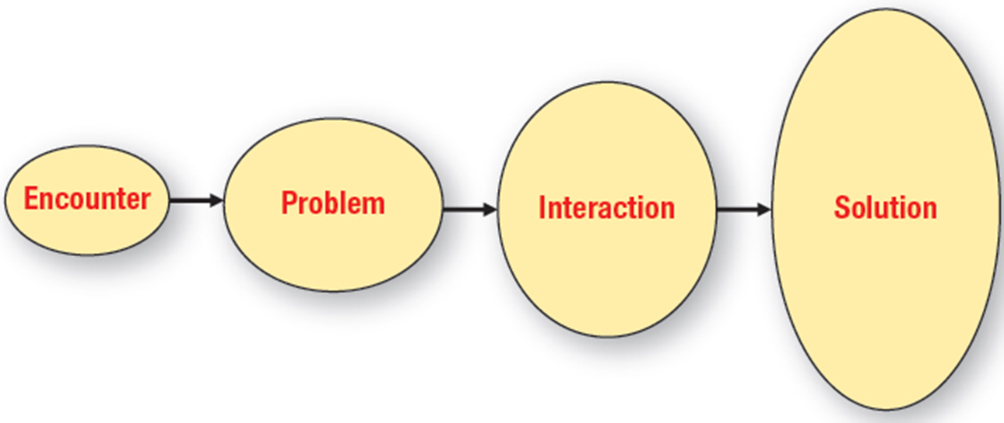
Figure 6.11: Components of a Slice-of-Life Execution
Notes:
The slice-of-life execution was made popular by Procter & Gamble in the 1950s. The basic premise is the introduction of a problem that a product solves. Slice-of-life has four components. It opens with an encounter between people or with a situation. A problem occurs. Then there is interaction, which can be a voice-over or conversation between two people. Then comes the P & G product that solves the problem. The typical detergent scenario is of a child’s uniform getting dirty and now it is not available for the championship game. The mother interacts with a neighbor who recommends Tide or Cheer, and the uniform is clean. Everyone is happy as the child runs out onto the field in a clean uniform.
The diagram flows as follows.
Encounter
Problem
Interaction
Solution

Slide 44
Storytelling Executions
Resembles 30-second movie
Plot or story
Brand is at periphery
Viewers draw their own conclusions
Notes:
Storytelling is similar to the slice-of-life execution, but does not include an encounter where the brand solves the problem. Storytelling resembles a 30-second movie, with a plot. The brand is more at the periphery of the ad, not its central focus. Rather than tell a brand’s benefits or attributes, the ad leaves the audience to draw their own conclusions.

Slide 45
Testimonial Executions
Business-to-business and service sectors
Enhance company credibility
Sources
Customers
Paid actors
Notes:
Testimonials are used in the business-to-business sector and the service sector. Testimonials involve customers giving testimonies about a product or service. Testimonies can enhance the credibility of a product. The testimonies can be given by real customers or by paid actors. Real customers are more believable, but lack polish for a TV ad. Paid actors sometimes look like paid actors, and the testimony benefits are lost.

Slide 46
Authoritative Executions
Expert authority
Scientific or survey evidence
Independent evidence
Business-to-business ads
Cognitive processing
Best in print media
Notes:
When using the authoritative execution, advertisers seek to convince consumers of the product’s superiority. The most common approach is to use some type of expert authority, such as a doctor, dentist, lawyer, or electrician. Scientific evidence or even survey evidence can be used to support the claim. It works best if the evidence is independent, such as Consumer Reports. The authoritative approach is used in business-to-business ads, especially in trade journals. Authoritative executions rely on cognitive processing of the information, so they work best with print media where copy can be supplied.

Slide 47
Demonstration Executions
Shows product being used
Business-to-business sector
Works best for television and internet
Notes:
A demonstration execution shows how a product works. A demonstration is an effective way to communicate the benefits of a product to viewers. It is used in business-to-business advertising to show how a product can meet the needs of a business. It works best for television and the internet.

Slide 48

Fantasy Executions
Go beyond reality
Common themes:
Sex
Love
Romance
Perfume/cologne industries
Notes:
Fantasy executions lift the audience beyond reality to a world of make-believe. Some are meant to be realistic, but most are fantasies that are irrational and would never really happen. The most common themes for fantasy executions are sex, love, and romance. As a result, fantasy executions work well for perfume and cologne. They also work well for clothing and vacation destinations. A few business-to-business ads have featured fantasies, but the danger is that customers will not take the business seriously. This Coleman Theatre ad utilizes a fantasy approach designed for brides-to-be.

Slide 49
Informative Executions
Used extensively in radio
Business-to-business
Best for high-involvement purchases
Correct placement vital
Notes:
Informative executions present information to the audience in a straightforward manner. They are used extensively in radio, often by DJs. Informative ads are less common in television and in print. Informative ads are common with business-to-business. The key to whether individuals pay attention is the buying situation. If someone is looking for a particular product, then they may notice the informative ad. Level of involvement is important. Consumers and business buyers have to be involved at the time to notice informative ads. Placement is also important. Ads placed next to an article on the topic are more likely to be noticed.

Slide 50
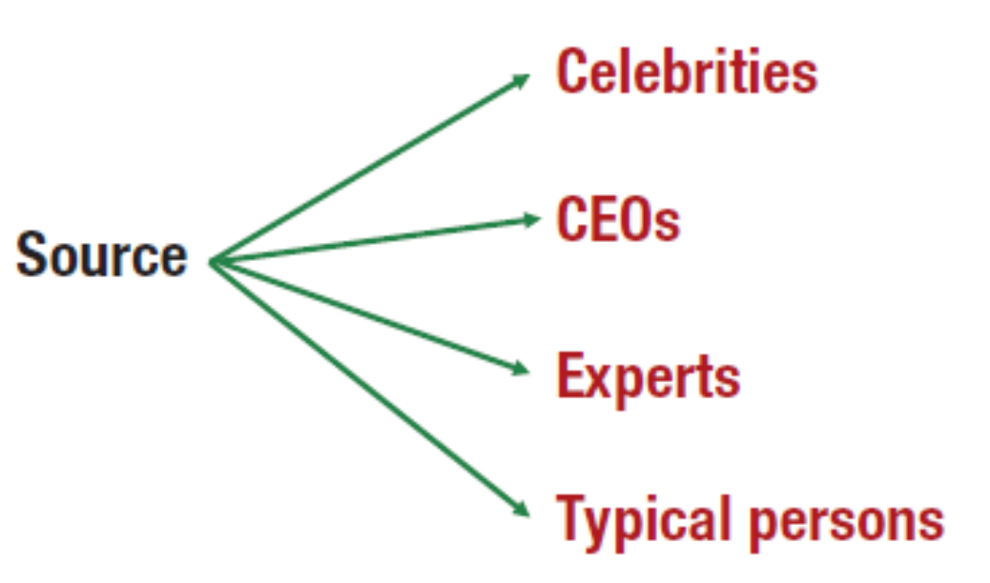
Figure 6.12: Types of Sources and Spokespersons
Notes:
Selecting the right source and spokesperson for an advertisement is a critical decision. Advertisers have four choices – celebrities, CEOs of companies, experts from various fields, and typical persons.
The diagram is structured as follows. Source splits into four subtopics of celebrities, C E Os, experts, typical persons

Slide 51

Celebrity Spokespersons
Most common
Small percentage of ads
Enhance brand equity
Create emotional bonds
More effective with younger consumers
Athletes popular
Define brand personality
Notes:
The most common type of spokesperson is the celebrity. They are featured in a small percentage of all ads. A celebrity can enhance brand equity and create emotional bonds with the brand. Celebrities are more effective with younger consumers than with older individuals. Athletes are a popular category of spokespersons. Celebrity spokespersons can be used to establish a brand’s personality.

Slide 52
Additional Celebrity Endorsements
Celebrity voice-overs
Quality voice
Voice recognition
Can be distraction
Dead person endorsements
Somewhat controversial
Becoming more common
Social media endorsements
Paid to endorse products
Paid to post tweets, comments
Notes:
Three additional categories of celebrity endorsements are: celebrity voice-overs, dead-person endorsements, and social media endorsements. Celebrity voice-overs are used because of the quality of their voice. Sometimes it is because the voice can be recognized and will influence consumers. At other times, the voice-over is a distraction because consumers pay too much attention to the voice and don’t hear the brand message. Another category, dead celebrities, is somewhat controversial. It is becoming more common because they can’t bring negative publicity to themselves or the brand. The newest form of celebrity endorsements is with social media. Celebrities are paid to post positive comments about a brand on social media, such as Twitter.

Slide 53
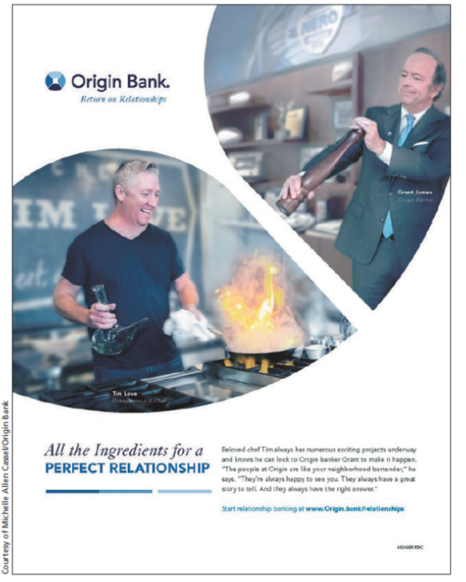
Spokespersons
C E Os
Highly visible, personable
Can be major asset
Used by local companies
Experts
Expert in their field
Authoritative figures
Typical persons
Paid actors
Typical, everyday people
Notes:
CEOs can be used as spokespersons. They work well if they are highly visible and personable. They can be a major asset to a company. They work especially well for local companies where consumers in that area know them personally, or at least have met them. Expert spokespersons should be experts in their fields. They then serve as authoritative figures and can provide expert opinions. The last category is typical persons. They can be either paid actors who portray a typical person, or everyday, ordinary people. This advertisement for Origin Bank features typical people.

Slide 54
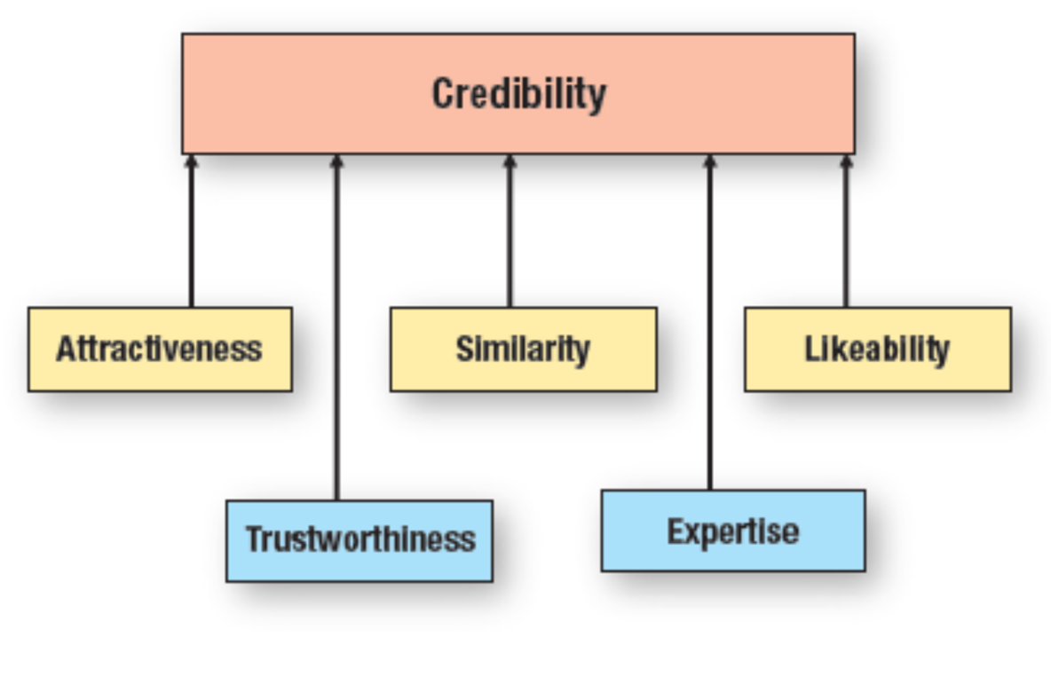
Figure 6.13: Characteristics of Effective Spokespersons
Notes:
In evaluating sources, companies and ad agencies consider several characteristics. The effectiveness of the spokesperson depends on his/her degree of credibility. The level of credibility is determined by five factors – attractiveness, trustworthiness, similarity, expertise, and likeability. The diagram shows credibility to be composed of attractiveness, trustworthiness, similarity, expertise, likeability.

Slide 55
Credibility Source Characteristics
Derived from five characteristics
Acceptance of individual and message
Believable
Most sources do not score high in all characteristics
Celebrities most likely to possess all characteristics
Notes:
Source credibility is derived from five characteristics: attractiveness, trustworthiness, similarity, expertise, and likability. Credibility determines the level of acceptance of the individual and his/her message. Credibility translates into the spokesperson being believable. Most sources do not score high on all of the dimensions. Celebrities are the most likely to possess all of the characteristics, at least to some degree.

Slide 56

Attractiveness Source Characteristics
Physical attractiveness
Personality attractiveness
Notes:
Attractiveness deals with both physical attractiveness and personality attractiveness. To be attractive, the spokesperson needs both. Someone who is physically attractive but has a rotten personality will not be a good spokesperson. Individuals who are physically attractive will be seen as more credible than less attractive people. A happy child improves the attractiveness of this ad for Ouachita Independent Bank.
The text at the bottom of the ad reads treat yourself to high interest checking plus savings.

Slide 57
Similarity Source Characteristics
Closely related to attractiveness
Allows for identification
Source has similar beliefs or attitudes
Preferences or behaviors similar
Aspiration similarity
Notes:
Similarity is important and closely related to attractiveness. Similarity allows for identification with the spokesperson. Identification can come from having similar beliefs, attitudes, preferences, or behaviors. Sometimes it comes from aspirations, something a consumer wants to be or has dreamed of being.

Slide 58

Likeability Source Characteristics
Consumers respond to sources they like
May like role an actor plays
May like an athlete because on favorite team
May like source because supports favorite cause
Transfer of dislike to brand being endorsed
Notes:
Closely related to attractiveness and similarity is likeability. Consumers respond to sources they like. That likeability can be derived in a number of different ways. An actor may be likeable because of a role he/she plays in a TV show or movie. If it is an athlete, the source may be a favorite player or on a favorite team. It may be that the source supports the consumer’s favorite charity. If someone likes the source, then that liking will usually transfer to the brand being endorsed. But, if for some reason an individual does not like a spokesperson, then that dislike will transfer to the brand also.

Slide 59
Trustworthiness Source Characteristics
Not all spokespersons are viewed as trustworthy
Degree of confidence or acceptance
Helps consumers believe message
Likeability and trustworthiness related
Notes:
Not all celebrities or spokespersons are viewed as trustworthy. Trustworthiness is the consumer’s degree of confidence in or acceptance of a spokesperson. Trustworthiness enhances the ability for a consumer to believe the message. Likeability and trustworthiness are closely related.

Slide 60
Expertise Source Characteristics
Sources with higher expertise more believable
Results in higher credibility
Can work to change opinions or attitudes
Notes:
Spokespersons with higher levels of expertise are viewed as being more credible. Expertise is often connected to a person’s livelihood or occupation. Expertise can be valuable in persuasive advertisements designed to change opinions or attitudes.

Slide 61
Matching Source Types and Characteristics
Celebrities
C E O
Expert
Typical person
Notes:
In choosing a spokesperson, it is important to match source types with characteristics. Celebrities tend to score high in credibility because they often score high on the other five dimensions. The risk is negative publicity and the endorsement of too many products, which lessen credibility. CEOs are typically seen as having high levels of trustworthiness, expertise, and credibility. But, not all are good on camera, so an agency must exercise care when selecting CEOs. For experts, seek those who are attractive, likeable, and trustworthy. Valid credentials are important. For typical persons, using multiple typical persons in an ad increases credibility. Using three customers to discuss a product may be better than using just one. Real people can be useful, but may not be effective on television, resulting in an ad that comes across poorly. Using actors helps because they are skilled at acting and learning lines. However, they may not appear to be real.

Slide 62
International Implications
Adapt to cultural differences
Be careful with language and translation
Adjust message strategy, appeal, execution
Notes:
In global markets, it is necessary to adapt message strategies, appeals, and execution to cultural differences. Companies need to be careful with translations and language.

Slide 63
Your Career: Resume and Application Letter Design
Design resume and application letter carefully
Consider cognitive message strategies from this chapter
List references with credibility and expertise
Spend time with supervisors and coworkers so they can provide positive future references
Notes:
Due to the level of competition you will face in seeking a job after graduation, the manner in which a resume and application letter are designed becomes vital. It will have an impact on whether you get an interview or are placed in the reject pile. The cognitive message strategies explained in this chapter will help determine the best approach to take.

Slide 64
Blog Exercises
Hepatitis C Ads
New Coke Flavor
Steak and Shake
Television Ads
Notes:
Access the authors’ blog for Chapter 6 at the URLs provided to complete these exercises. Answer the questions that are posed on the blog.

Slide 65

Copyright
This work is protected by United States copyright laws and is provided solely for the use of instructors in teaching their courses and assessing student learning. Dissemination or sale of any part of this work (including on the World Wide Web) will destroy the integrity of the work and is not permitted. The work and materials from it should never be made available to students except by instructors using the accompanying text in their classes. All recipients of this work are expected to abide by these restrictions and to honor the intended pedagogical purposes and the needs of other instructors who rely on these materials.

